Slide 1
Ecological Resilience: The American Dam, Past and Future
By: Heidi Scott, SESYNC

Slide 2
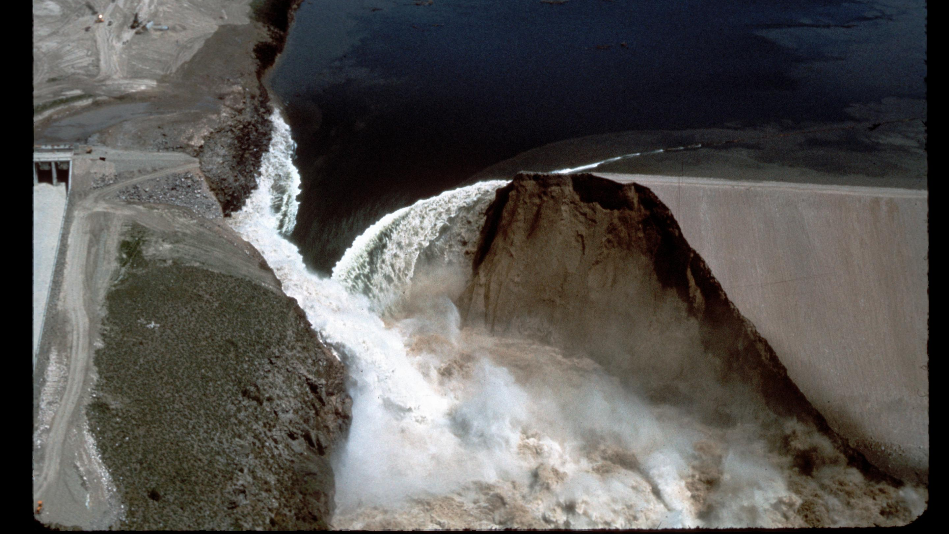
Teton Dam Flood, June 5, 1976
Image courtesy of www. waterarchives.org via Wikimedia Commons

Slide 3
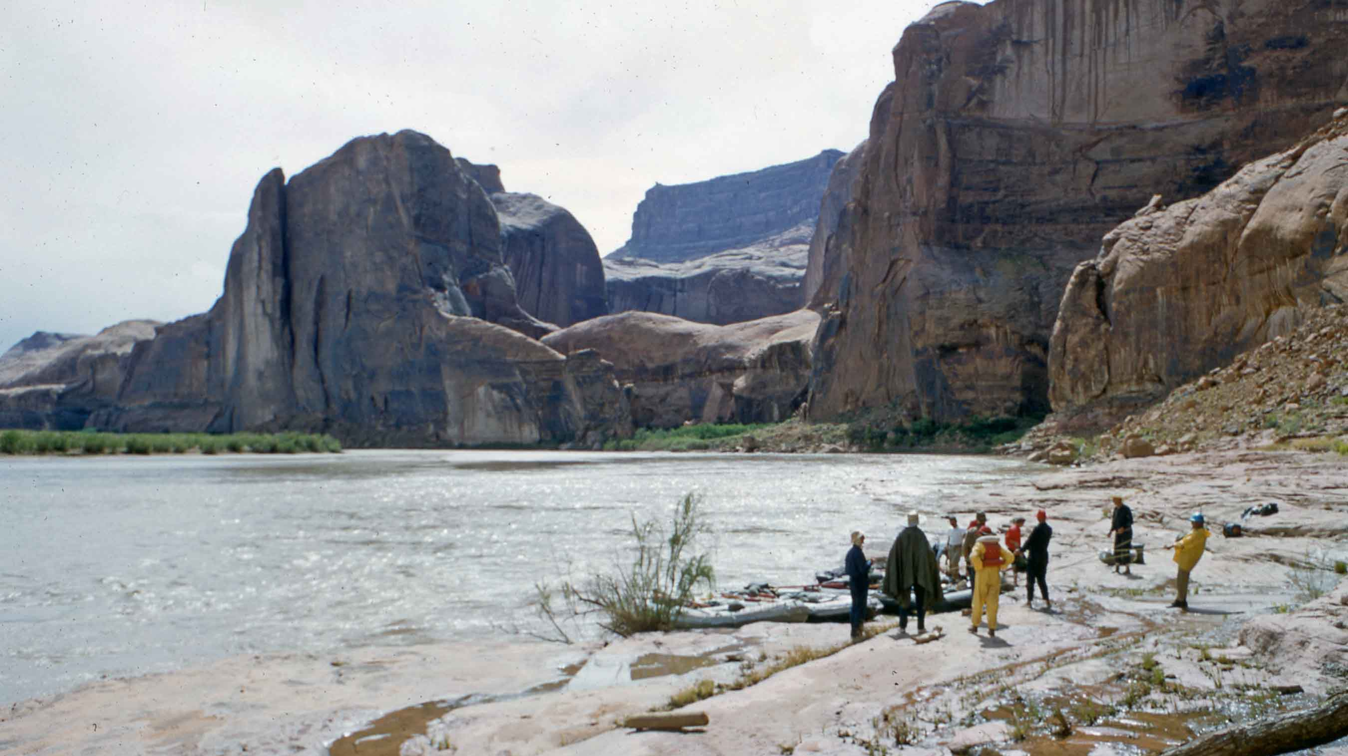
Downstream view taken on the bank of the Colorado River in Glen Canyon of Hidden Passage Canyon before the construction of Glen Canyon Dam, c. 1958 Open-source image via Wikimedia Commons

