Slide 1
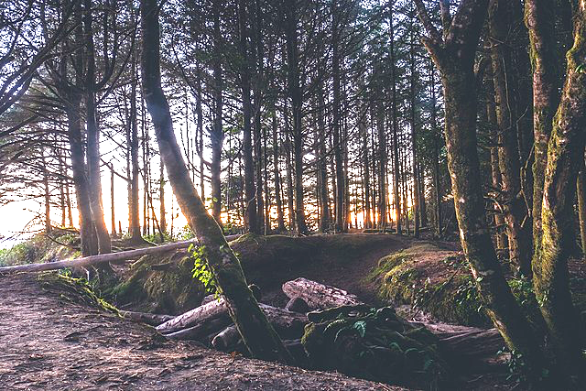
Urban Forest Patches Lesson 2: Socio-Environmental Services

Slide 2
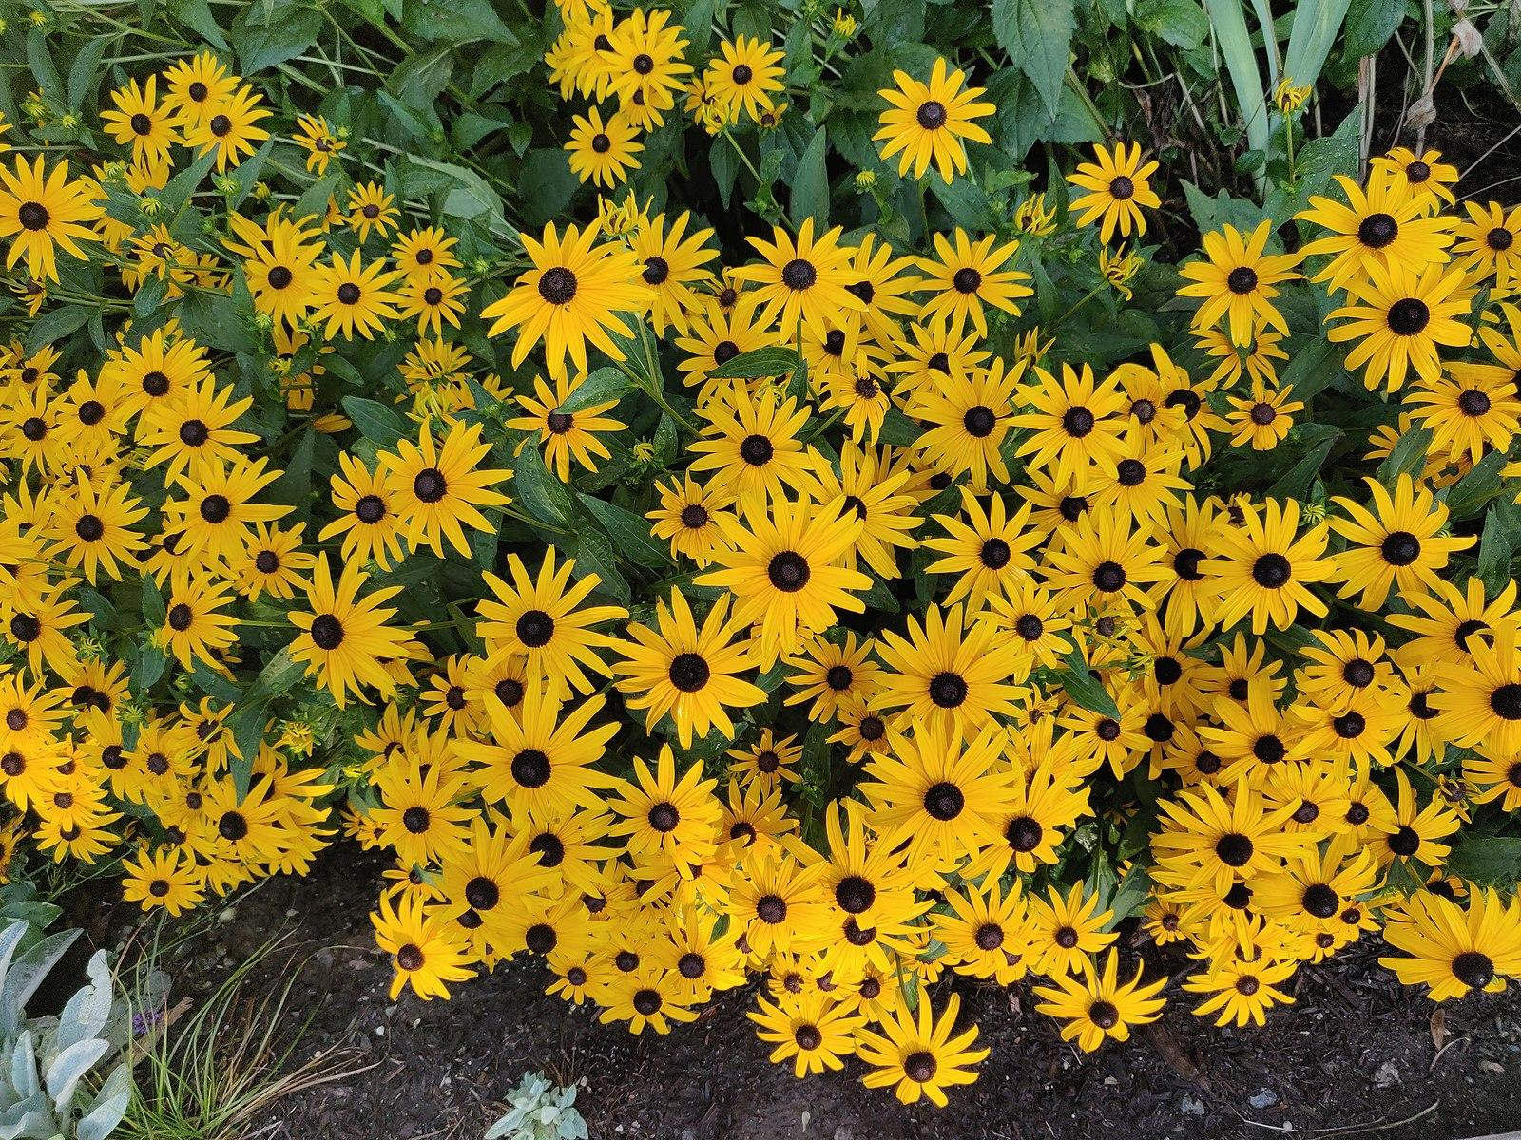
Management of Urban Forest Patches (UFPs)
Ecosystem Services (ES):
Ecosystem managers have many competing goals:
Should the UFP serve nature, humans, or both?
What management choices enhance multiple ES?
What choices are tradeoffs between rival ES?
Notes:
Instructors might detail some professions that fall under the general category of “ecosystem managers”: Federal and state government workers in natural resources departments (state DNRs, FWS, NPS); park rangers; scientists working with park groups; even amateur naturalists who lead interest groups or maintain local spaces (invasive species removal, planting, pollinator gardeners).
Also: Ask learners to think about what types of complementary uses may fulfill both ecosystem services to humans and aid other species. Tree canopy, wildflowers, and greenways are all examples of beneficial outcomes for humans and non-humans.

Slide 3
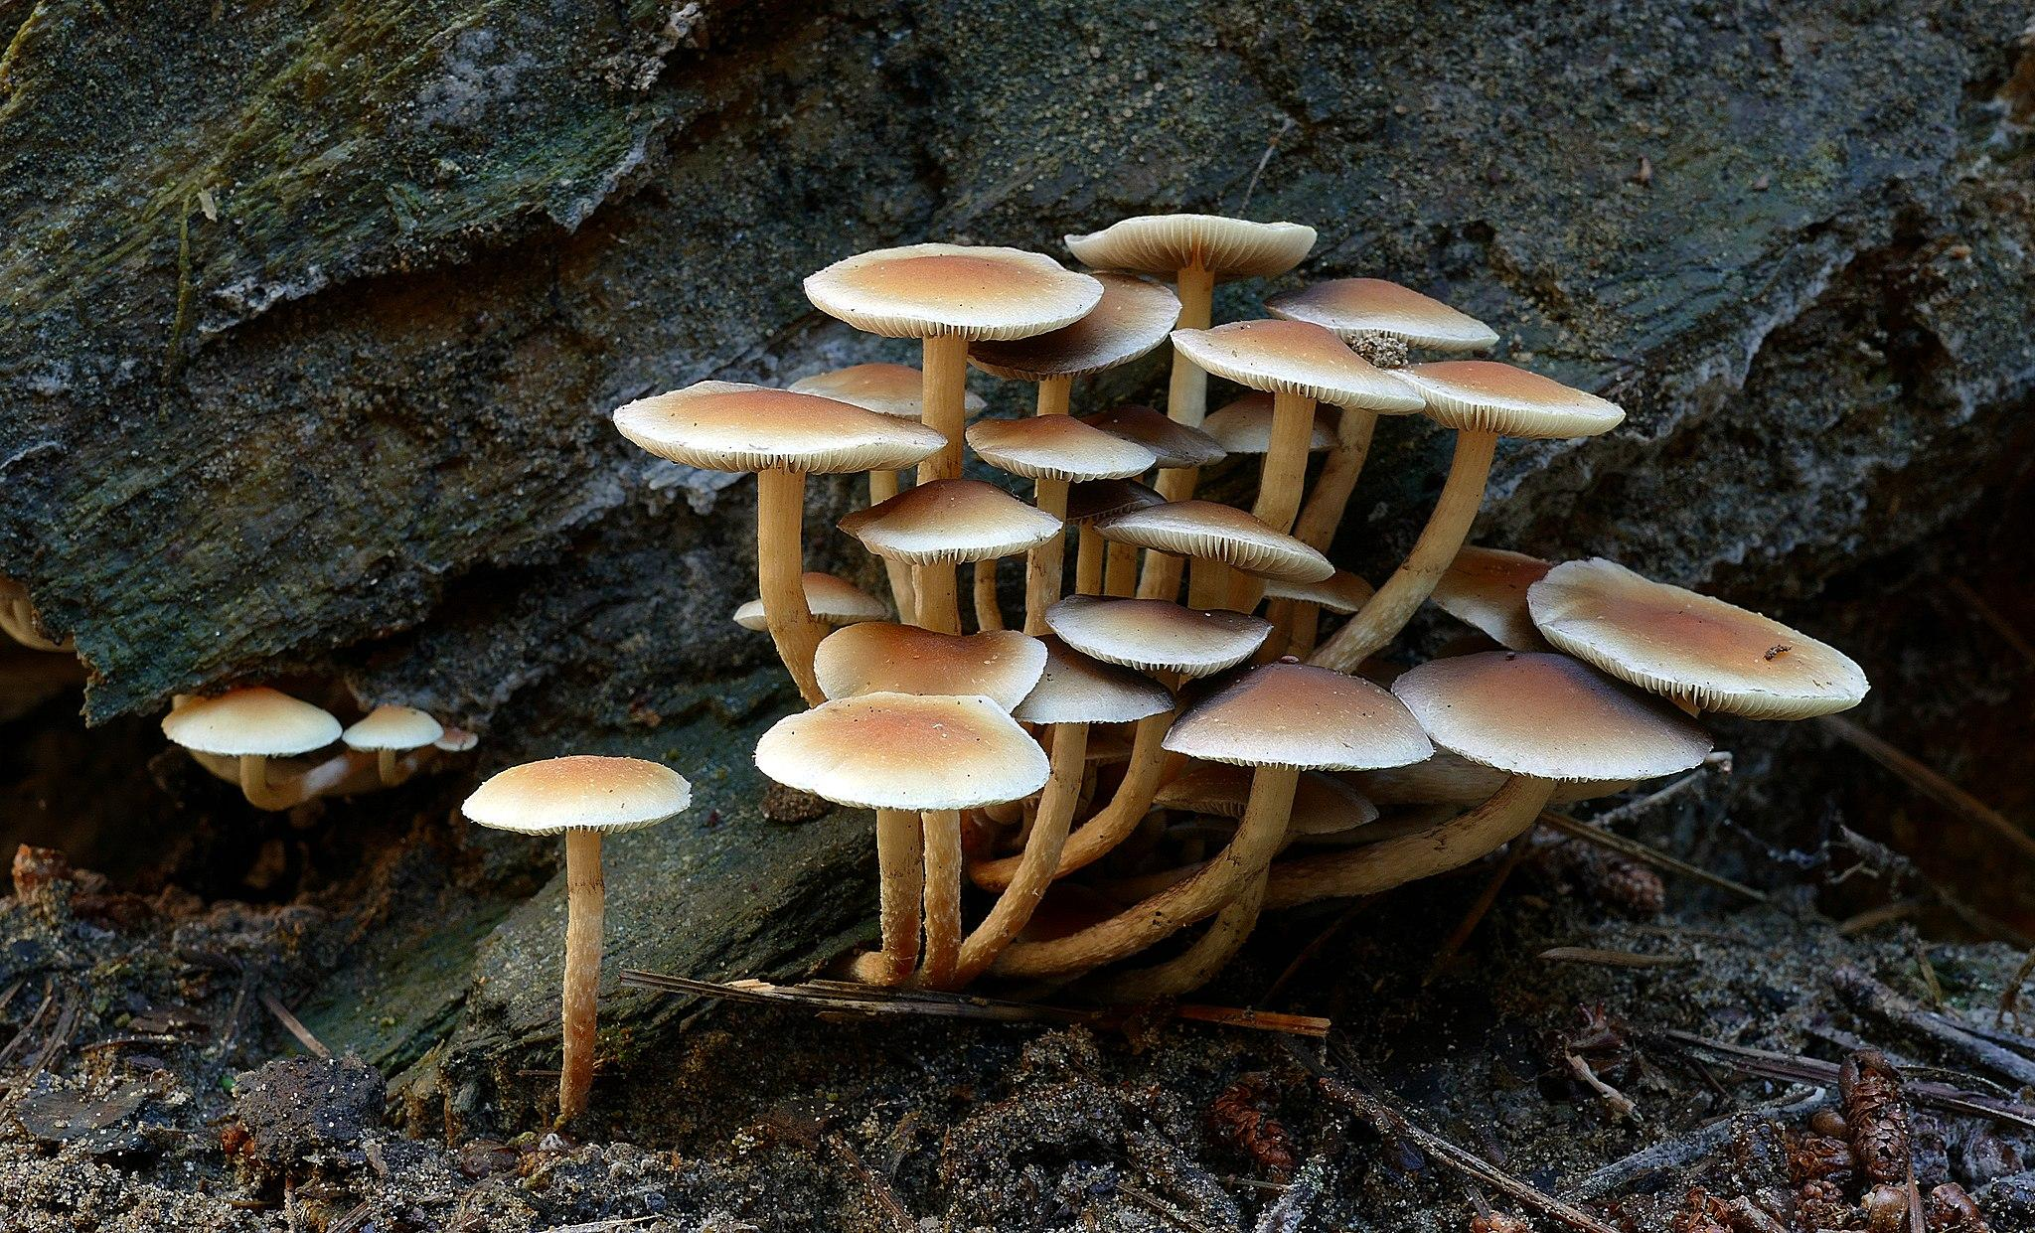
Management of Urban Forest Patches (UFPs)
Examples:
Aesthetics: Dead Wood:
Human preference for “tidy” forests
Versus habitat and soil quality provision of deadwood
Versus forest fire danger posed by dead biomass
Local Climate Regulation: Canopy Cover:
Reducing urban heat islands with total tree cover
Versus recreational spaces like open fields for sports
Versus pollinator gardens with full-sun wildflowers
Notes:
Instructor: Ask learners to name other ES tradeoffs that affect management choices. Do these choices seem directed by particular cultural factors, such as adherence to historical ecosystems (classic Restoration Ecology), priority of human benefits over ecological community benefits, factors of budget and financing, or development priorities? Ask them how choices related to managing UFPs may face new challenges and find new priorities as cities grow and climate change stresses our infrastructure and experience of nature.

Slide 4
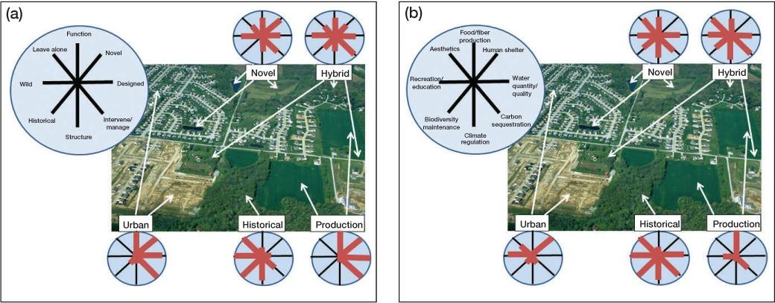
Diagramming Ecosystem Services Across Multiple Priorities
Managing the whole landscape: historical, hybrid, and novel ecosystems by Hobbs et al.
Two perspectives on a typical landscape found in peri‐urban areas worldwide. Panel (a) illustrates how diverse landscape elements are differentiated along a range of gradients in characteristics and management emphases (expanded from Kueffer and Kaiser‐Bunbury 2014), whereas panel (b) indicates how different elements provide differing combinations of ecosystem services. The opportunities and constraints vary greatly among elements. This type of mixed landscape is increasingly prevalent as urban areas grow and is often the locus for community conservation and restoration projects. Although the landscape depicted is relatively small scale, similar issues can be identified at broader scales incorporating large nature reserves and production landscapes.
Notes:
Instructor: Direct learners’ attention to the two related but distinct “rose diagrams” of parts a) and b). While a) is useful in demonstrating how historical traits and management regimes may help compare and distinguish between different UFP scenarios (note esp. the inverse relationship between “Production” and “Historical” patches), it is b) that will serve as an analytical model for this lesson. Learners will focus on one of the eight ES in their analysis of how the target UFP may be managed for optimal and complementary ES provision. At this point, simply note how the rose diagram works, and that “novel ecosystems” show some provisioning in seven ES—all except “Human shelter.” Despite the derision that has be directed toward novel UFPs, the rose diagram presents an impressive array of benefits, more than “urban” or “production” or even some elements of “historical” UFPs.

