Slide 1
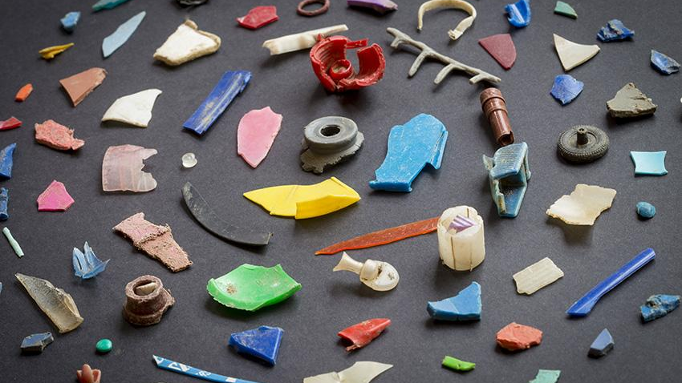
The Wicked Plastics Problem
12/13/22
Notes:
Notes to Instructor: It may interest learners to ponder how our geological imprint in the Anthropocene will be written largely in plastic and atmospheric CO₂ emissions from fossil fuels. How will future generations look upon our mountains of polymer waste? What polymer relics from 1950–2050 might make our cultures of waste appear ironic, amusing, disgusting, or monstrous to them?

Slide 2
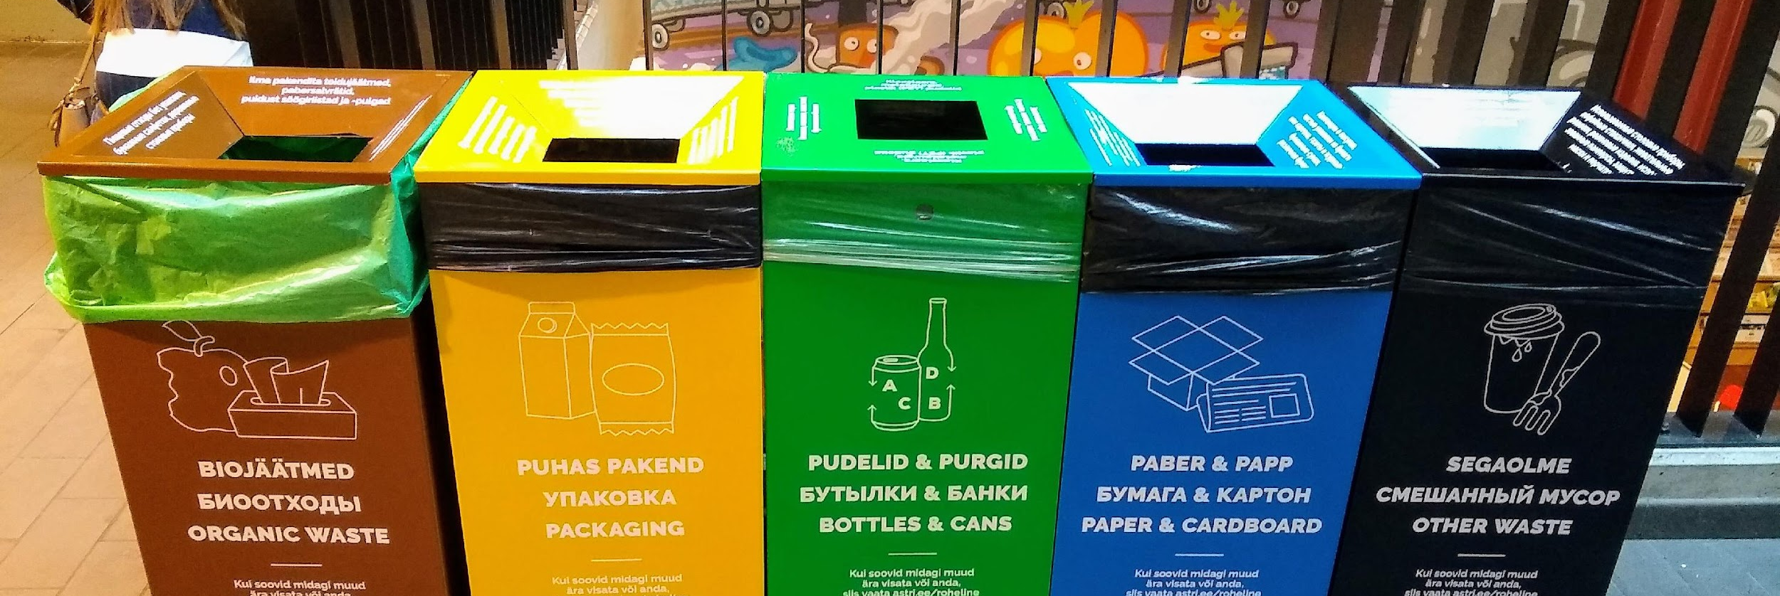
Reduce, Reuse, Recycle
The Three Rs are listed in order of least environmental impact:
REDUCE use of plastic wherever possible. If you must buy plastic,
REUSE and repurpose the plastic to extend its useful life. If it is useless,
RECYCLE the plastic—if possible. Plastic with #1 and #2 symbols are most frequently recycled.
Notes:
Notes to Instructor: Ask learners: Have you ever engaged in “wishful recycling” where you’re not sure whether an item is recyclable, but you put it in the bin anyway? This is understandable due to the complexity and confusion surrounding recycling symbols and bins, but it is a major problem that causes the contamination of whole batches of recyclable plastic. How can we turn “wishful recycling” into a past mistake by altering the materials, methods, and structural processes of recycling? How can we avoid having to recycle in the first place?

Slide 3
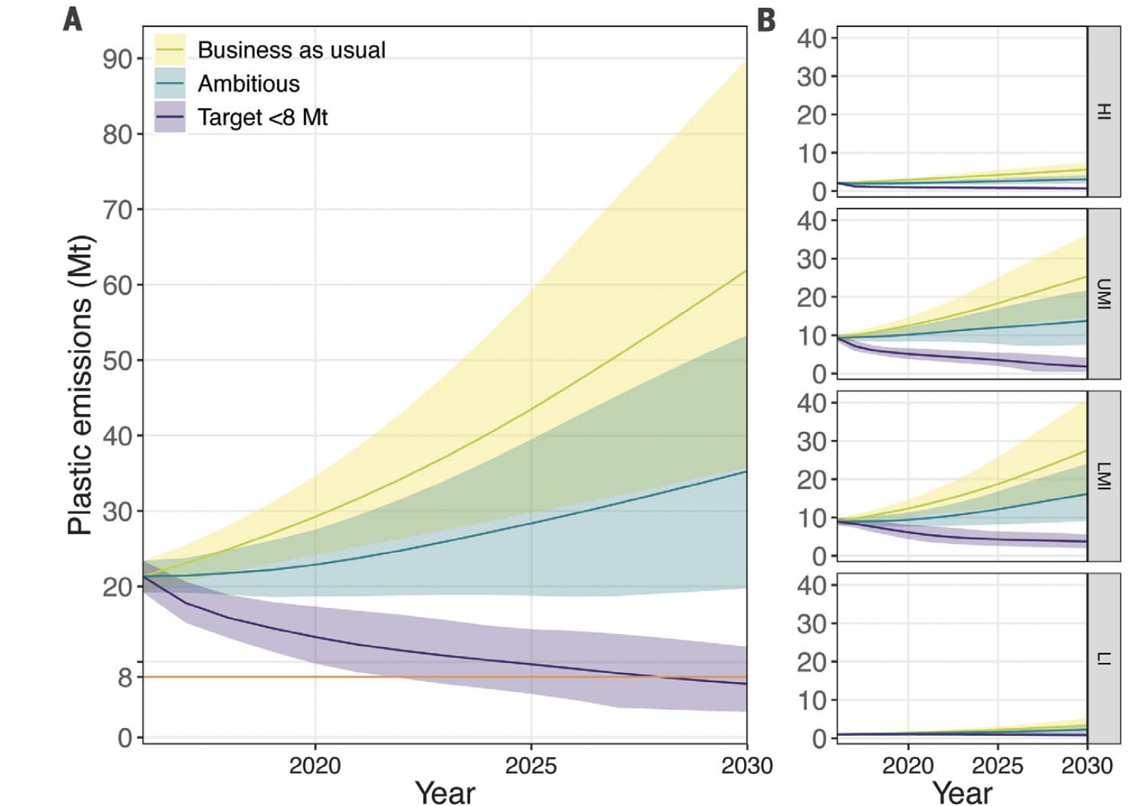
Borrelle et al. 2020 Predicted growth in plastic waste exceeds efforts to mitigate plastic pollution
Figure 1: Annual global plastic emissions into aquatic ecosystems. Data include major rivers, lakes, and the oceans in million metric tons (Mt from 2016 to 2030) (A) and for each income status (B) as defined by the World Bank (17) showing the BAU (yellow), ambitious (blue), and target <8 Mt (purple) scenarios. Shaded areas represent 80% credible intervals indicating the uncertainty in plastic waste generation and the scenario implementation into the future. Orange horizontal line represents the target of <8 Mt, which is a frequently cited statistic in global policy discussions as an unacceptable amount of plastic emissions to the marine ecosystem alone (a subset of the aquatic ecosystems considered here) (7).
Borrelle et al. (2020). Predicted growth in plastic waste exceeds efforts to mitigate plastic pollution Science, 369(6510), 1515–1518. https://doi.org/10.1126/science.aba3656
Notes:
Notes to Instructor: Note that this lesson will focus on the “target” scenario in purple, which reduces marine pollution to a target of 8 MT by 2030. The idea is to ratchet up every existing diversion technique and develop new approaches in policy, materials science, and bioremediation to reduce plastic pollution by 2030. This is not the most likely scenario, since virgin plastic production is set to increase significantly in the coming decade. Also note the challenges differ based on “high income” versus “upper middle,” “lower middle,” and ”low income” countries.

Slide 4
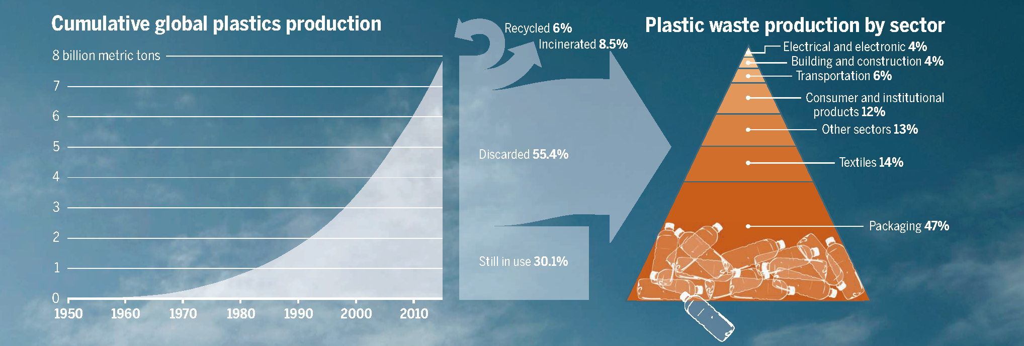
Figure from: Smith, J., & Vignieri, S. (2021). A Devil’s Bargain. Science, 373(6550), 34-35. https://doi.org/10.1126/science.abj9099
To reach target marine waste reductions to 8MT by 2030:
Reduce or Eliminate the use of unnecessary plastics.
Packaging alone causes 47% of plastic waste (Smith and Vignieri 2021).
Set global limits for virgin plastic production.
Production caps, taxes, and requirements to integrate recycled plastic at increasing rates (50% recycled by 2030; 80% by 2040) (Break Free From Plastic Pollution Act, 2021).
Borrelle et al. 2020
Notes:
Notes to Instructor: Review the low-hanging fruit in reducing plastic waste: packaging. Have learners discuss the ways they’ve encountered excessive plastic packaging and any methods they’ve used to avoid consuming it. How can we progress beyond reusable shopping bags and water bottles?

Slide 5
Borrelle et al. 2020
To reach target marine waste reductions to 8MT by 2030:
3. Create global standards to recover and recycle plastic by design.
Advances in materials science can cut polymer molecules down to building blocks
for producing advanced recycled plastic.
Seek systemic implementation of container reuse and bottle-deposit systems.
4. Develop and Scale plastic processing and recycling infrastructure.
Clarify consumer options to recycle; achieve better transparency on recycling rates.
Promote global policy and investment in developing countries’ recycling options.
Image by AMB Enterprise Karachi via Wikimedia Commons, Attribution 4.0
Notes:
Notes to Instructor: Note that Borrelle et al. identify “middle income” countries as creating the largest share of plastic pollution. How does global inequality contribute to the waste problem? Consider wealthy countries’ offshoring waste to developing countries, lack of waste management facilities, and the lag of cultures used to biodegradable materials in adapting to plastic waste. Also consider how citizens in developing countries have been innovative in creating profit from unregulated waste, as trash pickers in landfill sites. Is this the way we want to provide employment for waste workers in developing countries? What would a better system look like?

Slide 6
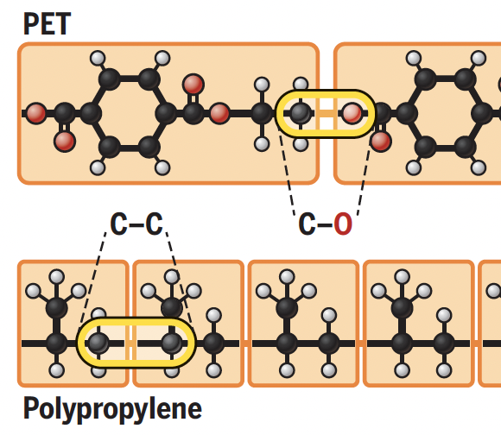
The Plastic Eaters by Cornwall
Organisms use enzymes to break down tough plant fibers, and some subsist on plastic waste.
Microbes on plastic bags that are stuck in mangrove roots are a promising start to the investigation.
How do microbial enzymes bind to polymers and break their chemical bonds?
Can fungi provide bioremediation by revealing evolved enzymes that splice polymers?
It is harder to break C-C bonds than other elements bonded to carbon; this is a problem with C-C bonded polymers like PE and PP.
Image selected from figure “Breaking Bonds,” p. 38. in: Cornwall, W. (2021). The Plastic Eaters. Science, 373(6550). https://doi.org/10.1126/science.373.6550.36
Notes:
Notes to Instructor: These theoretical fixes are in the early stages of development. Still, seeking enzymes that have evolved in plastic-polluted environments is an intriguing new angle for biomimicry.

